Slide 1
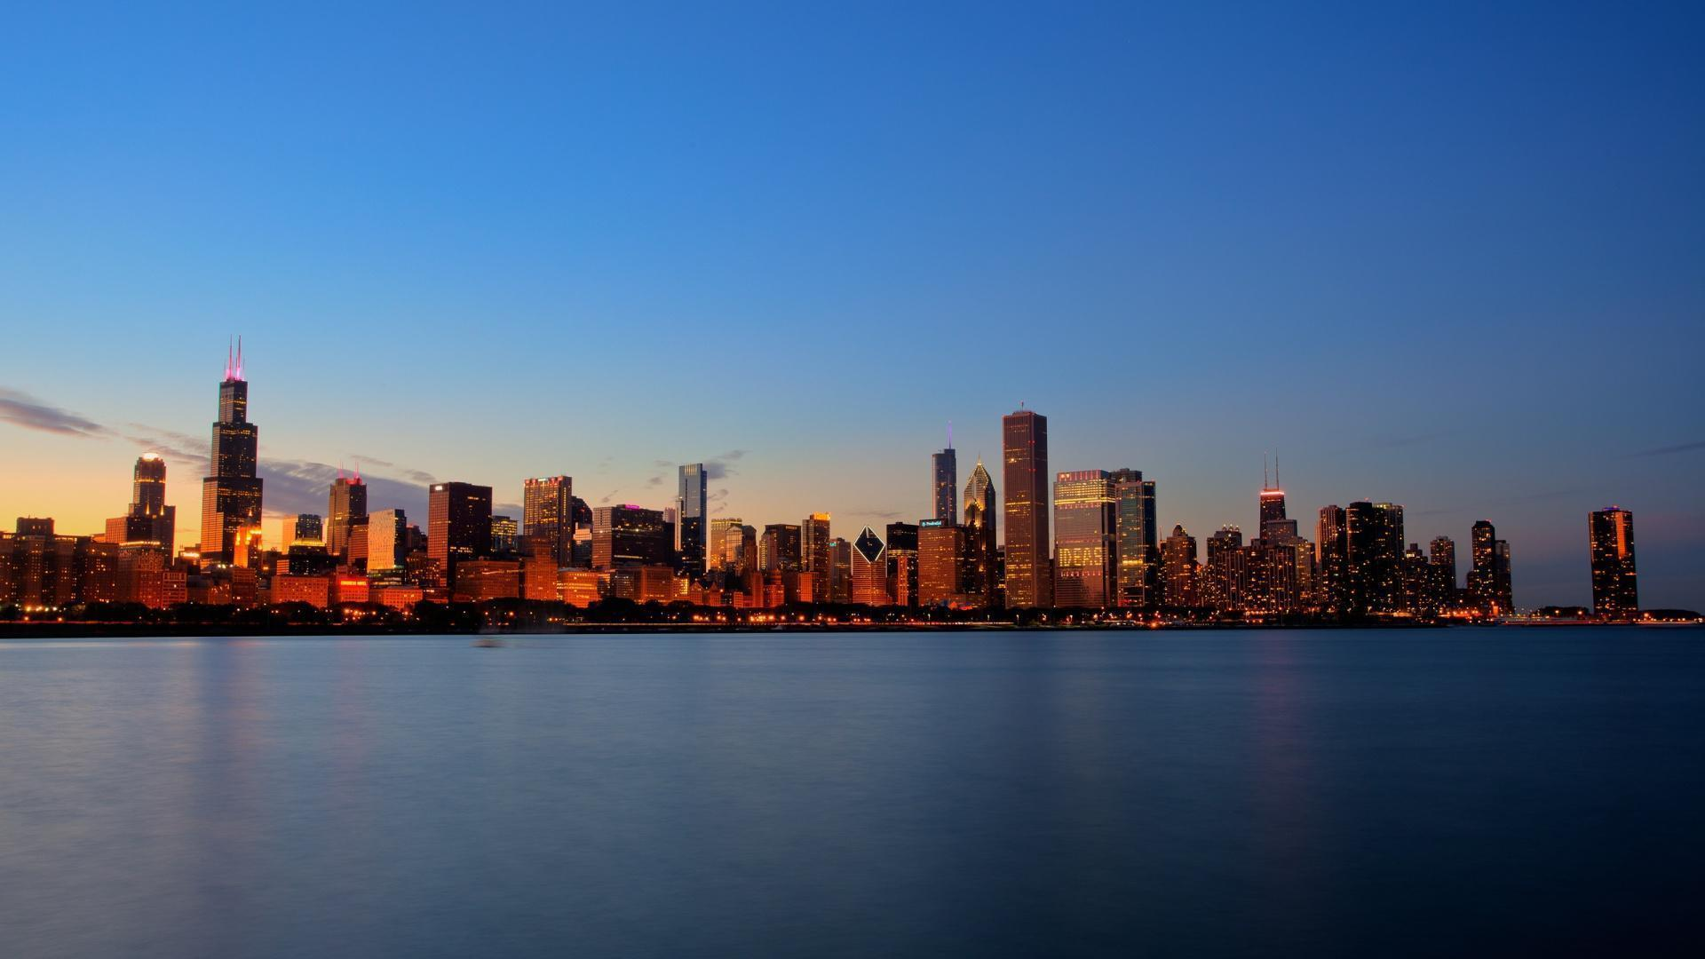
Restaurant diversity in Boston neighborhoods
IBM Data Science Professional Certificate
Capstone Project
Brian Schaefer
April 17, 2020

Slide 2
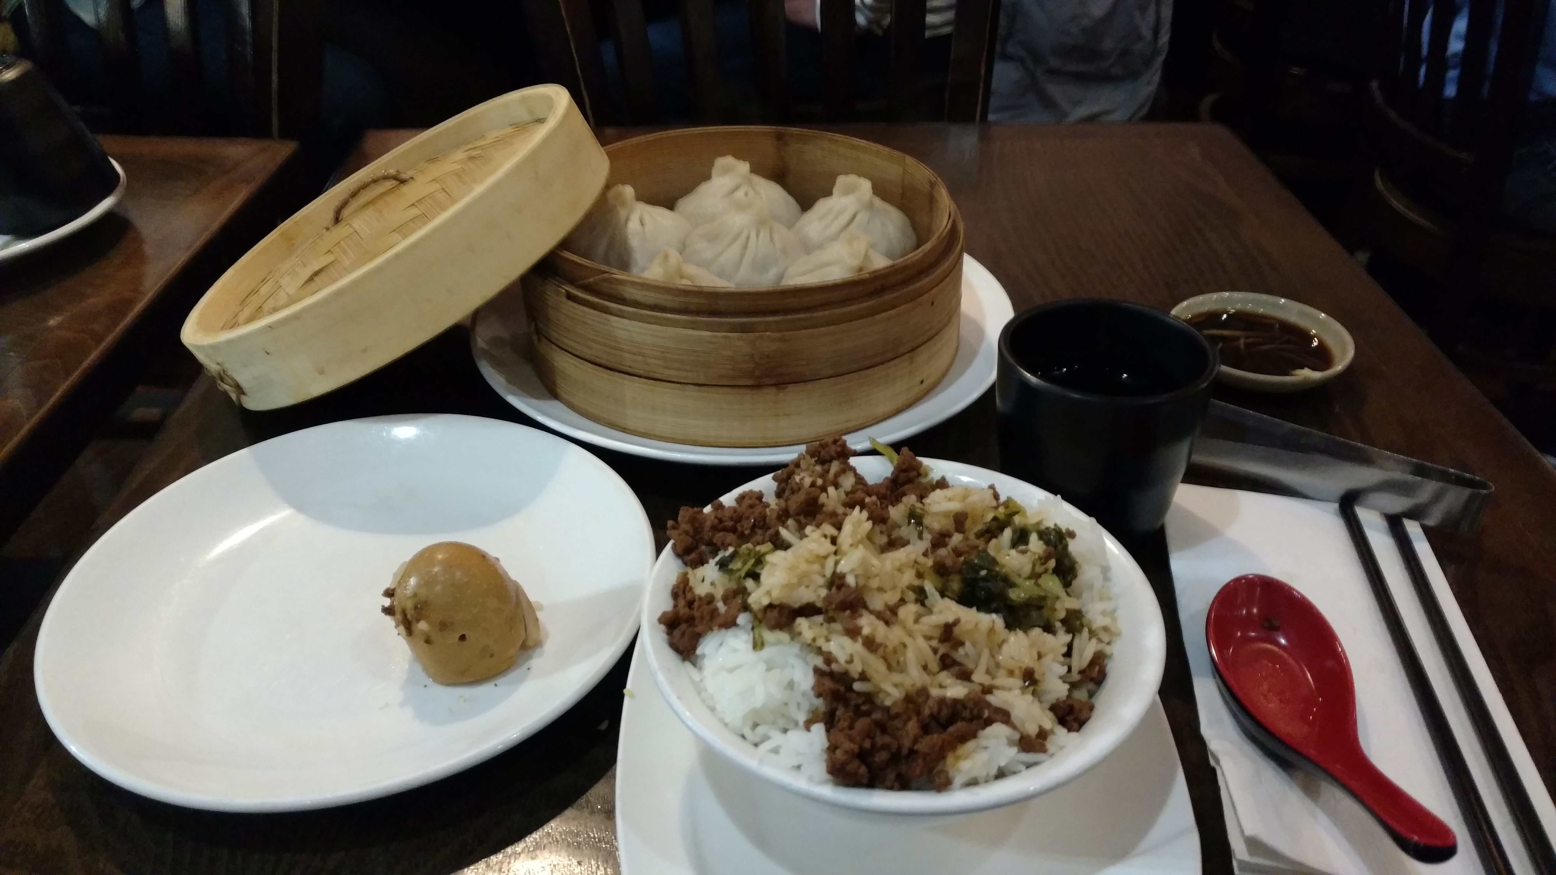
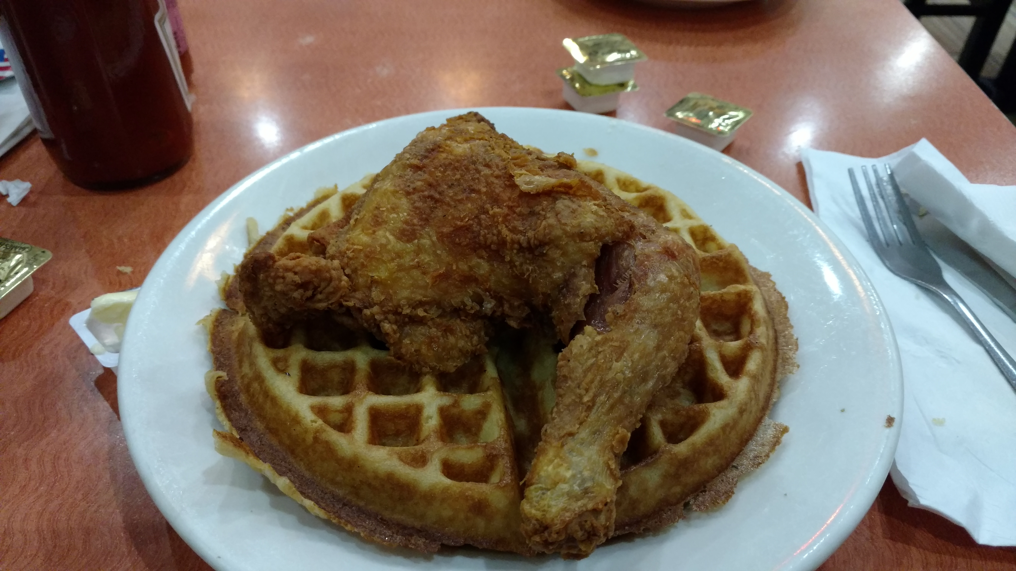
Objective: Find the neighborhoods in Boston with the most diverse restaurants
Where should someone visit or live if they want access to diverse cuisines, like Taiwanese dumplings and Southern fried chicken and waffles?

Slide 3
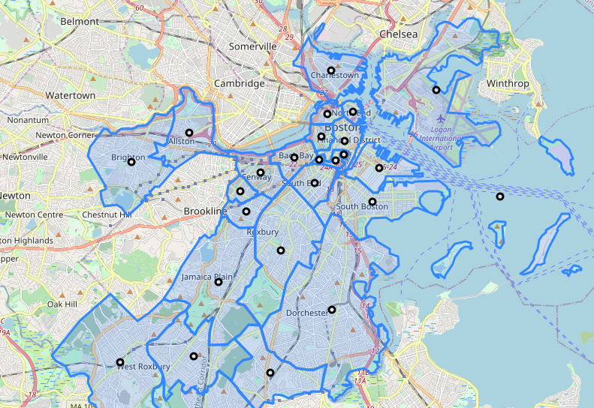
Boston Neighborhoods
Geographical data (GeoJSON format):
https://data.boston.gov/dataset/boston-neighborhoods
Centroids (black) calculated from polygon boundaries

Slide 4


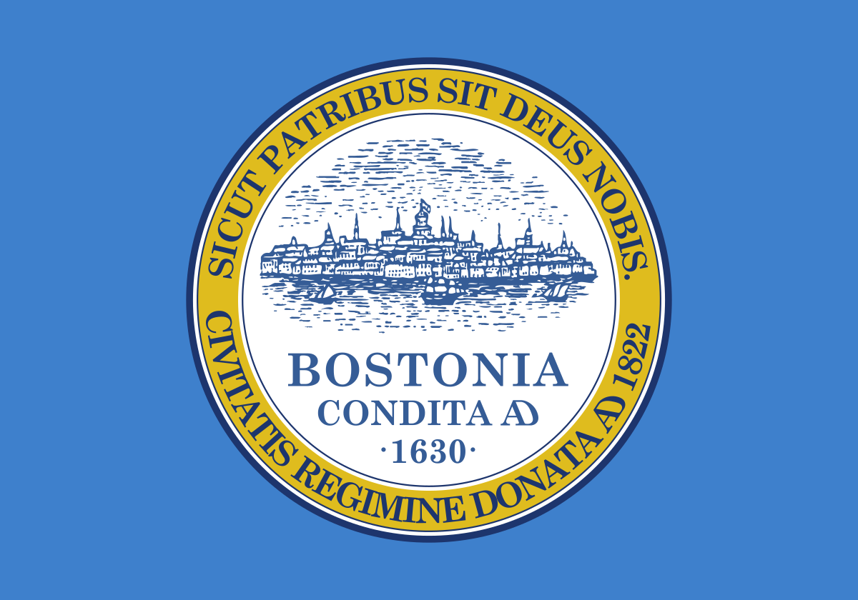
Boston Neighborhoods
North End
Some neighborhoods are known for a particular cuisine:
Chinatown
Seaport District
Roxbury
Could this neighborhood have more diverse cuisine?
Geographical data (GeoJSON format):
https://data.boston.gov/dataset/boston-neighborhoods
Centroids (black) calculated from polygon boundaries

Slide 5
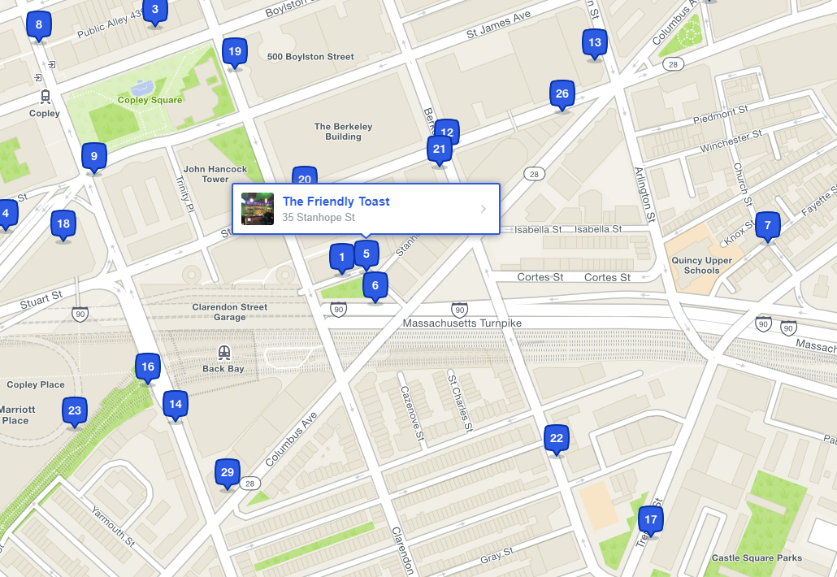
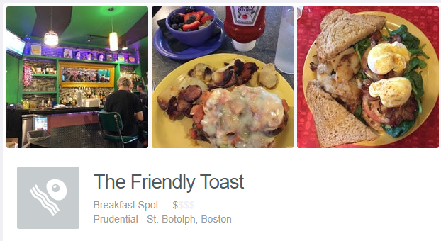

Exploring restaurants
Use the Foursquare API to search for “Food” venues around the geographical centroid of each neighborhood
Information for each venue:
Venue name (“The Friendly Toast”)
Venue category (“Breakfast Spot”)
Geographical coordinates
Address

Slide 6
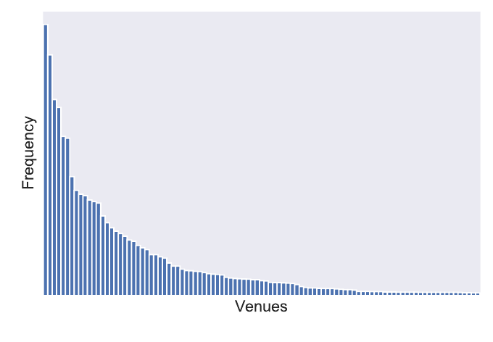
Distribution of venue types in Boston
Pizza place
Coffee shop
Café
Creperie
Noodle House
Wings Joint
…

Slide 7
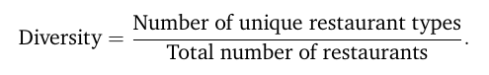
Diversity index
Define a “diversity index”
Accounts for neighborhoods that might have a large number of restaurants
Does not count multiple restaurants of the same type
A useful metric for determining the diversity of restaurants in a neighborhood

Slide 8
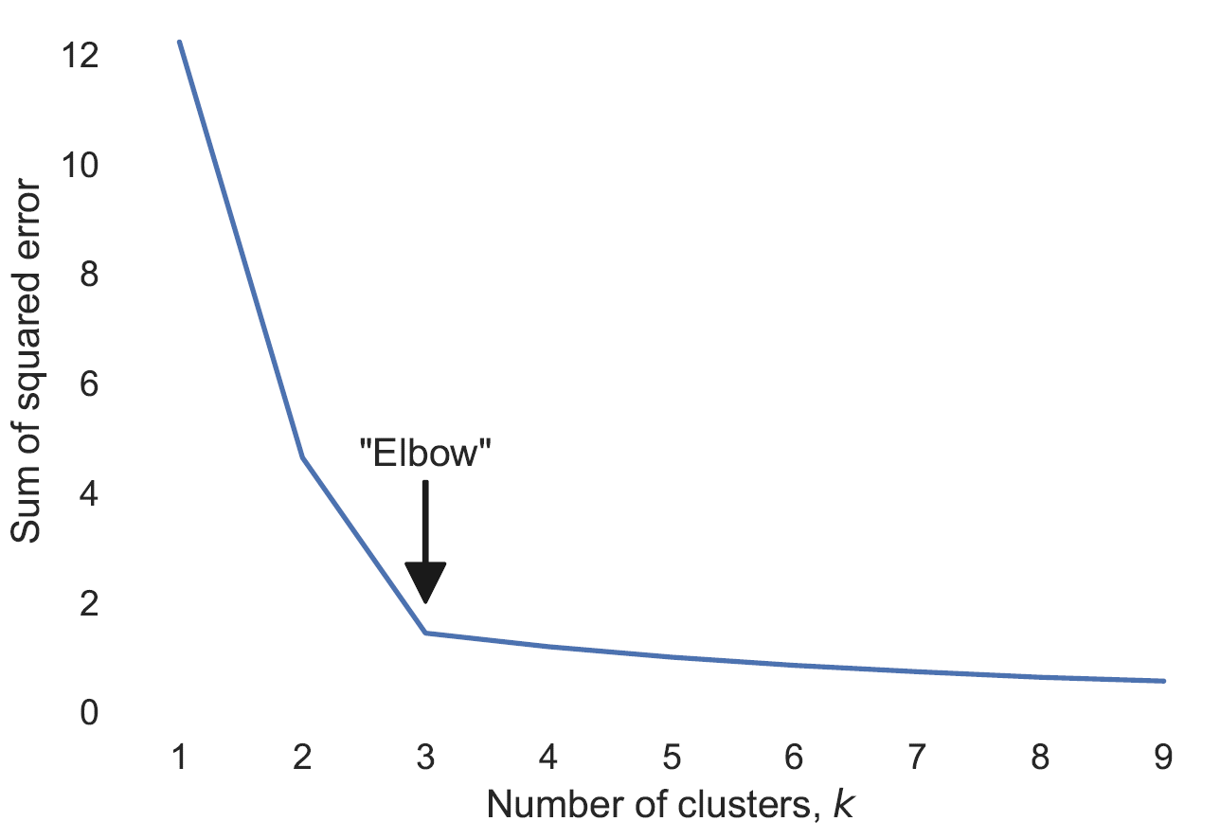
Data classification
k-means clustering
Assignment of neighborhoods into clusters based on similarity of their feature vectors
Feature vectors consist of information related to the number of restaurants of each type
Use “elbow” method to determine a useful number of clusters (k=3)
In the end, these clusters could be labeled “high diversity”, “moderate diversity”, and “low diversity”

Slide 9
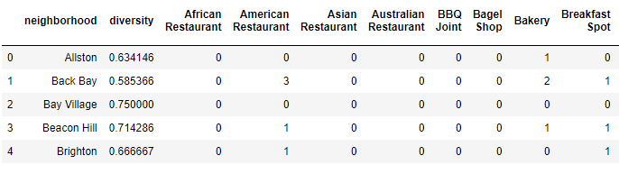
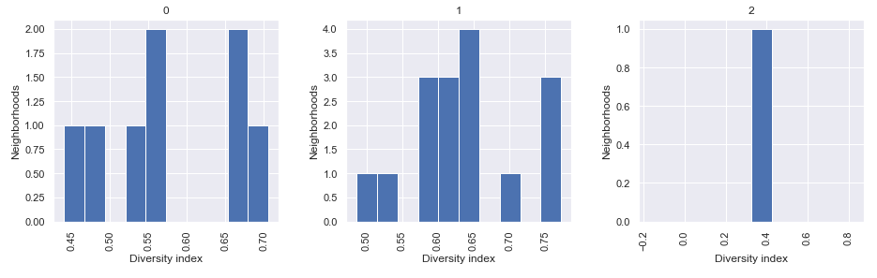
Clustering with restaurant counts
Data: counts of numbers of each type of restaurant in the neighborhood
Cluster 2: North End (many, many Italian restaurants) restaurants
Cluster 0: Pizza places, cafés
Cluster 1: A variety of restaurants

Slide 10
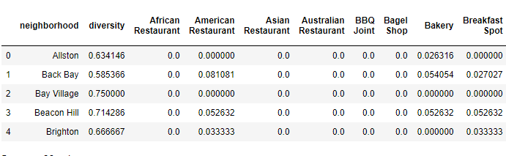
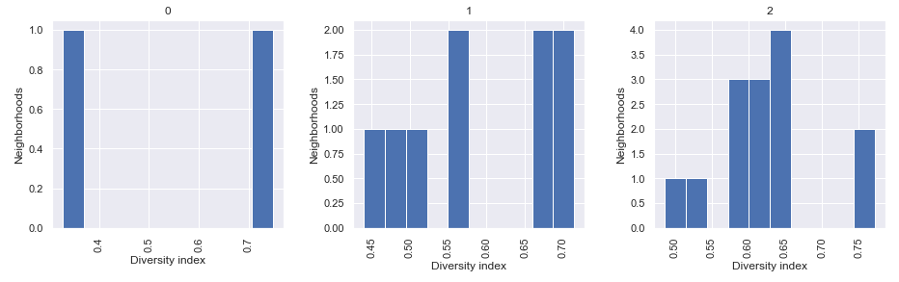
Clustering with restaurant proportions
Data: proportion of each type of restaurant out of the total number of restaurants in the neighborhood
Cluster 0: Italian most popular
Cluster 1: Pizza places, cafés
Cluster 2: A variety of restaurants

Slide 11
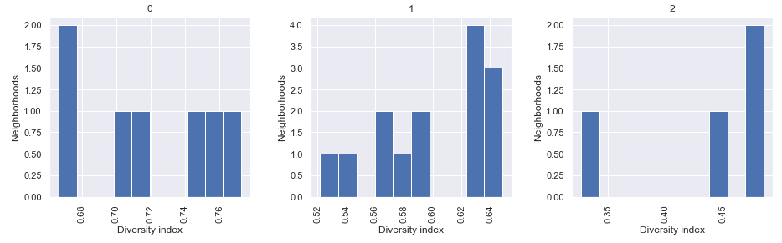
Clustering with diversity index
Data: diversity index for each neighborhood
Cluster 0: Most diverse
Cluster 1: Moderately diverse
Cluster 2: Least diverse

Slide 12
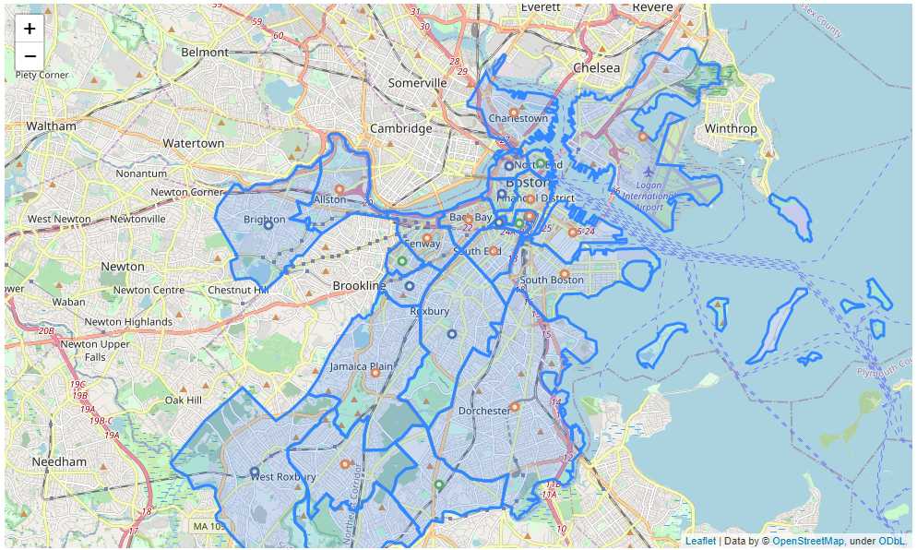
Final clustering
Least diverse
Chinatown (Chinese)
North End (Italian)
Longwood (a medical campus)
Mattapan (Afro-Caribbean)
Moderately diverse
Most diverse
Bay Village
Beacon Hill
Brighton
Mission Hill
Roxbury
West End
West Roxbury

Slide 13
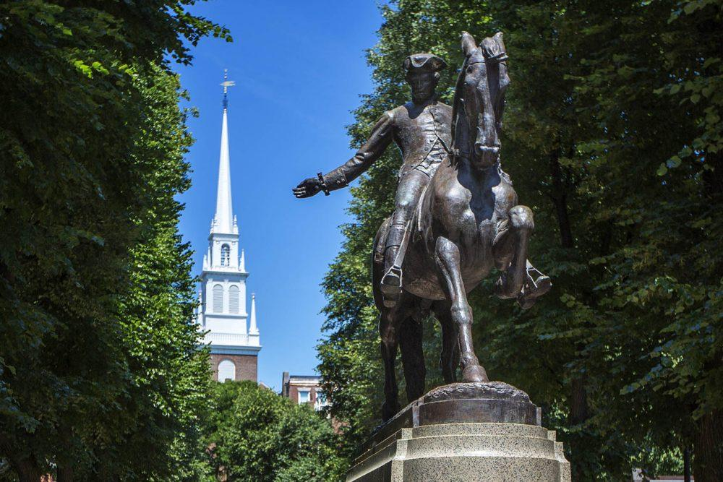
Conclusions
Used Foursquare data and “diversity index” to classify Boston neighborhoods on variety of restaurants
Great neighborhoods for the adventurous palate:
Bay Village
Beacon Hill
Brighton
Mission Hill
Roxbury
West End
West Roxbury

